Slide 1
Plan Driven and Agile Programming
Patient Management System (PMS)-2019/2020

Slide 2
Project Structure
Analysis Phase
UML class diagram ^{*1}
Extensive textual report
Implementation Phase – 1 (Mid Term optional)
UML class diagram
Detailed textual report
Javadoc
Source code
Executable code (with execution instructions)
Implementation Phase – 2 (End of Semester)
The same with the Phase - 1
Detailed documentation of potential differences between Phase-1 and Phase 2
Project examination (oral and code)
^{*1}Use specialized tools such as: Visual paradigm, NetBeans UML plugin & IBM Rational Rose.

Slide 3
Basic guidelines
For the implementation
Never forget the data encapsulation principle.
Make use of inheritance where it makes sense
Make use of polymorphism where it can and does make sense
Never forget to document your source code (eg javadoc). If necessary give appropriate examples.
Separate the structure of your program so that it is easy to find what you are looking for at a time (see proper project design, package usage, etc.).
Always think before you start coding!
Learn how to learn / search. "Never ask your teachers before you already understand and thoroughly look for solutions to your problem."

Slide 4
Description
The project consists of Patient Management System (PMS) which is a part of Hospital Management System (HMS). This project contains seven modules namely-Admin, Receptionist, Doctor, Payment Counter, Clinic Center, Inpatient and Online Registration.
Hospitals must need to maintain the information of the patients very accurately and up to date. The information helps the doctors to treat the patients very efficiently.
Also the hospital must maintain the information of the patients for n number of years and the episodic information

Slide 5
System Functions

Slide 6
System Functions: 1/1
Patient’s Information
The whole information regarding different activities in the hospital is entered in the registers manually for future verification.
The patient details like Personal Information are all entered in registers. Each Patient’s information will be maintained in a separate file.
If the patient gets any new ailments, their details, reports must be added to the previous information.
All the information regarding the patient from entering the hospital to leaving the hospital must be maintained accurately.
Doctor’s Information
The information regarding all doctors and their qualifications, their personal details all are maintained in a separate file. Each doctor has a unique id.
The doctors’ availability times all are maintained in a separate file.

Slide 7
Software Functions

Slide 8
Software Functions: 1/2
Study of the Proposed System
Collection of data in a standard format designed in an efficient way.
Create a Database, which should be:
Integrated
Sharable
Reliable
Secure
Any incomplete or invalid data will not be accepted as there are thorough checks at each and every stage of all forms.
The software will handle the following functions:
Authorization
All the staff in the hospital will be given a user name and password for login in to the system.
Different Menu Accessing Permissions will be given to different cadered people.
Depending on the validity of the username and password entered, the software will become accessible to the authorized users.
Patient Information
Patient personal information like name, age, sex, occupation, fathers name etc. will be maintained.
Each patient is given a unique PIN (patient index number).
Each patient is assigned to a particular doctor.

Slide 9
Software Functions: 2/2
Doctor’s and other staff Information
Every doctor and staff member will be given a unique id.
Their personal information like contact numbers are maintained.
Their availability on that day will be maintained.
Patient reports and bills
The reports and bills of a patient are stored in the database for further verification.
The cost of each test is maintained.

Slide 10
Functionalities of the modules

Slide 11
Functionalities of the modules: 1/3
Login:
Once User enters the valid userid and password user move to the page that displays corresponding services of that user.
ADMINISTRATOR:
Administrator is the one who will be having complete authority over the software.
He is the one who will decide to whom the access over the software is to be granted.
He is responsible for entering new user information, updating their information, and deleting the information when the user no longer exists.
RECEPTIONIST:
It works round the clock. Initially the patient is admitted as OP.
Depending upon his condition he is then admitted as the IP.
Emergency cases are accepted near the causality Counter.
This module automates the day-to-day administrative activities and provides instant access to other modules, which leads to a better patient care.

Slide 12
Functionalities of the modules: 2/3
DOCTOR:
The doctor module is the important module of the Patient management system.
Once the doctor enters the hospital, he will log into the system to see the list of patients allotted to him.
When the patient meets the doctor, the doctor will examine him and prescribes him the necessary medicines to be taken and tests if there are any to be performed.
The patient after undergoing all the tests visits the doctor with the test report.
Depending on the results of the test, the patient may be advised to stay at the hospital.
PAYMENT COUNTER:
The payment counter module handles all types of billing for long-term care.
This module facilitates cashier and billing operations for different categories of patients like Outpatient, Inpatient.
It provides automatic posting of charges like lab tests conducted in different departments.
The payment counter module is extensively flexible by which each of our billing plans can be configured to automatically accept or deny

Slide 13
Functionalities of the modules: 3/3
CLINIC CENTER:
Clinic Center module starts with receiving tests from doctors and also allows laboratory personnel to generate requests.
The Clinic Center Module supports to perform various tests under following disciplines: Biochemistry, microbiology etc. Tests are performed only after billing is done.
This rule is exempted when the case is declared as urgent
INPATIENT:
Depending upon the test results generated by the Clinic Center, the doctor decides the status of the patient i.e., whether he is an inpatient or an outpatient.
In case, if the patient is declared as in, then the respective patient goes to the receptionist counter and the receptionist there, will allot him a bed in the required ward.
At the time of discharge, this inpatient has to pay the maintenance fee along with the test fee and the registration fee depending on the number of days he stayed in the hospital.
ONLINE REGISTRATION:
In Online Registration, the user can “sign up” into the system, so that he can get username and Password(chosen by him/her).
As soon as the patient get username, he can now login to the system and will be provided with different services.
When he/she fills the form, will be given the appointment date, time and the doctor allotted to him by the Receptionist.
He can edit his profile.

Slide 14
System Requirements

Slide 15
System Requirements: 1/1
This is oriented, comprehensive and standardized user-friendly software.
This software is easy to use and saves a lot of time of the staff in different cadres, as it can quickly respond to the user requests in an efficient manner.
Helps in speedy information retrieval.
Extra information from various tables in a single query.
It performs thorough validation checking while storing. It assists the user with respective messages to overcome the errors at runtime.
It can generate different types of reports according to the user needs.
You are free to use anyone OOP programming language.
The architecture of your implementation must be based on the MVC design pattern.
Also, you must use 2 more design patterns that you were taught in the class.
You are free to structure and build the Graphical User Interface in your own way.
The data processing module, should be presented in a way that all available data are shown and as well as the fields must be editable.
Each change in the data should be update directly the database and shown in the GUI.
The program is running until you press the close.

Slide 16
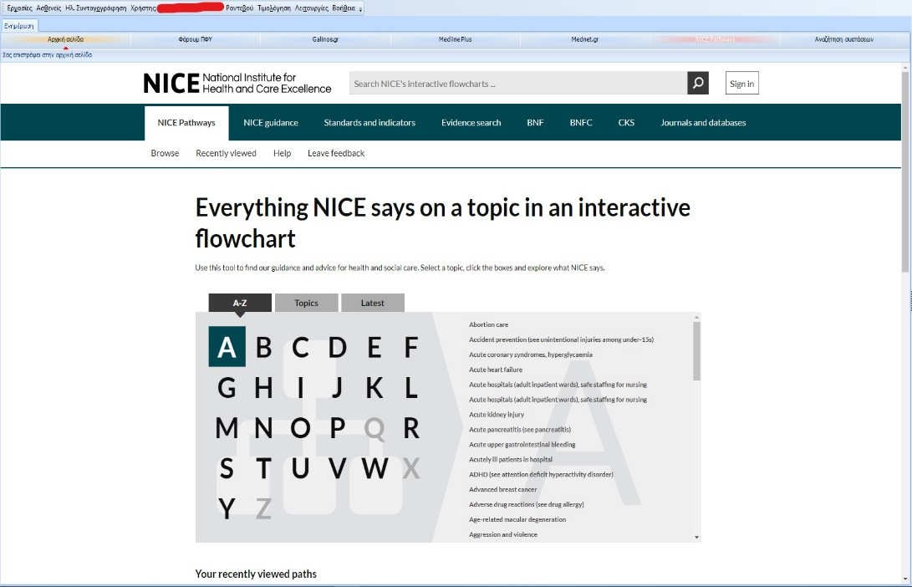
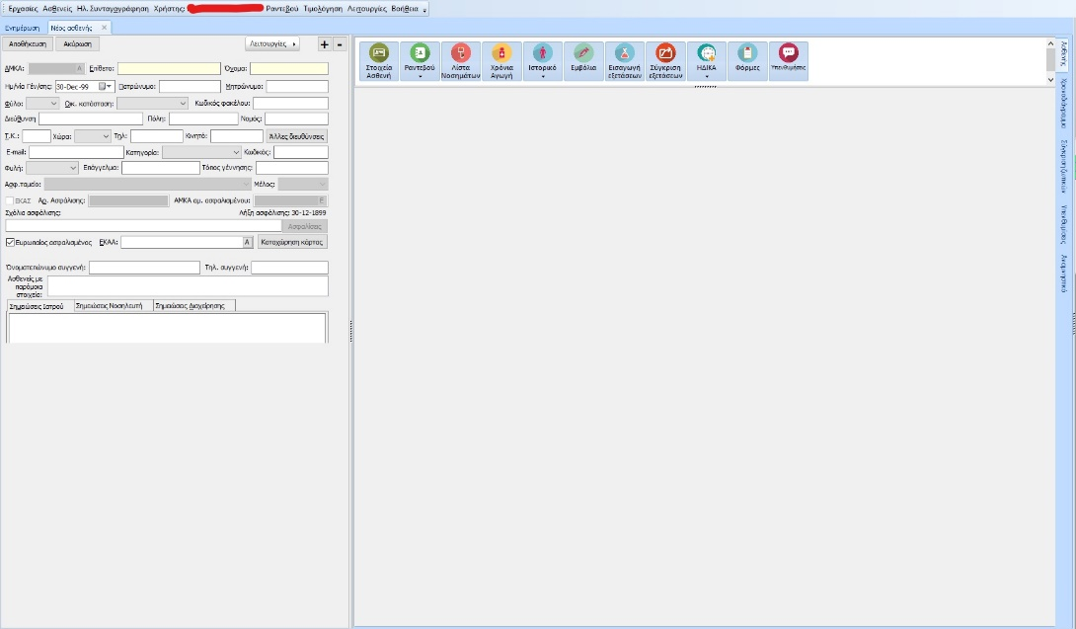
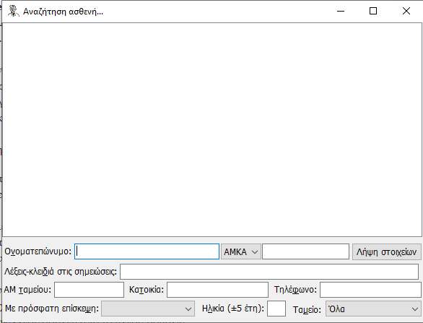
Examples Of PMS: 1/1

Slide 17
Project Team
Project Design and Analysis
Vidakis Nikolas, Kontoulis Vasilis
Project Implementation Monitoring
Vidakis Nikolas, Kontoulis Vasilis
vkontoulis@hmu.gr
Distance Project Implementation Monitoring
Vidakis Nikolas, Kontoulis Vasilis
vkontoulis@hmu.gr

Slide 18
Dead Line | Title – Scheduled Deliverables
Week-1
Week-2
Week-3
Week-4
Week-5 | ‘ANALYSIS PHASE’ DELIVERABLE. This Week is an optional deliverable date. The mandatory date is the week before the Official Laboratory exam week.
Week-6
Week-7
Week-8 | ‘PHASE 1’ DELIVERABLES This Week is an optional deliverable date. The mandatory date is the week before the Official Laboratory exam week.
Week-9
Week-10
Week-11 | ‘PHASE 2’ DELIVERABLES This Week is an optional deliverable date. The mandatory date is the week before the Official Laboratory exam week.
Week
Week
Week | ‘ORAL EXAMINATION’ The ORAL exam date is the week before the Official Laboratory exam week.
Week | ‘WRITTEN EXAMINATION’ EXAM week is the Official Laboratory exam week.

